Slide 1
Evolutionary Computing
Chapter 3 – What is an Evolutionary Algorithm?

Slide 2
Common model of evolutionary processes
Population of individuals
Individuals have a fitness
Reproduction / variation operators
mutation
recombination (a.k.a. crossover)
Selection towards higher fitness
“survival of the fittest” and
“mating of the fittest”
The fitness of the population increases over time

Slide 3
Two pillars of evolution
There are two competing forces
Increasing population diversity by variation
mutation
recombination
Push towards novelty
Decreasing population diversity by selection
of parents
of survivors
Push towards quality
Selection operators act on population level
Variation operators act on individual level

Slide 4
What is an Evolutionary Algorithm?
Scheme of an EA
Main EA components:
Representation / evaluation / population
Parent selection / survivor selection
Mutation / recombination
Excercise: eight-queens problem
EA behaviour
EAs in context

Slide 5
General scheme of EAs
Parent selection
Parents
Intialization
Population
Variation
Termination
Offspring
Survivor selection

Slide 6
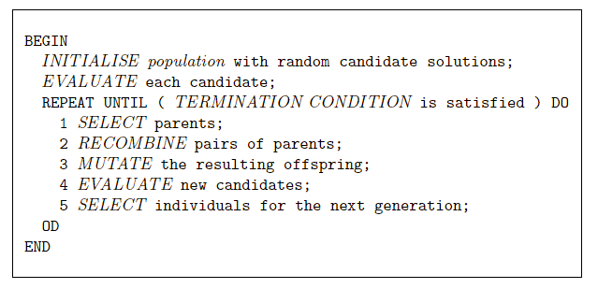
EA scheme in pseudo-code

Slide 7
Main EA components: Representation
Role: provides code for candidate solutions that can be manipulated by variation operators
Leads to two levels of existence
phenotype: object in original problem context, the outside
genotype: code to denote that object, the inside (chromosome, “digital DNA”)
Implies two mappings:
Encoding : phenotype → genotype (not necessarily one to one)
Decoding : genotype → phenotype (must be one to one)
Chromosomes contain genes, which are in (usually fixed) positions called loci (sing. locus) and have a value (allele)
Notes:
TSP

Slide 8
Some terminology
Variable vs. value
Gene vs. allele
Example:
x vs. 3.14
color vs. red

Slide 9
Main EA components: Representation
Example: represent integer values by their binary code
Phenotype space
Genotype space
Encoding
(representation)
10010
18
10
2
9
1001
Decoding
(inverse representation)
In order to find the global optimum, every feasible solution must be represented in genotype space
Notes:
Optimium double example

Slide 10
Main EA components: Evaluation / fitness function
Role:
Represents the task to solve, the requirements to adapt to (can be seen as “the environment”)
Enables selection (provides basis for comparison)
If some phenotypic traits are advantageous, desirable, e.g., big ears cool better, then these traits are rewarded by more offspring that will expectedly carry the same trait
A.k.a. quality function or objective function
Assigns a single real-valued fitness to each phenotype which forms the basis for selection
So the more discrimination (different values) the better
Typically we talk about fitness being maximised
Some problems may be best posed as minimisation problems, but conversion is trivial

Slide 11
Main EA components: Population
Role: holds the candidate solutions of the problem as individuals (genotypes)
Formally, a population is a multiset of individuals, i.e., the same element might occur multiple times
Population is the basic unit of evolution, i.e., the population is evolving, not the individuals
Selection operators act on population level
Variation operators act on individual level
Notes:
Minimise the route > maximise the saved paths

Slide 12
Main EA components: Population
Some sophisticated EAs also assert a spatial structure on the population e.g., a grid
Selection operators usually take whole population into account i.e., reproductive probabilities are relative to current generation
Diversity of a population refers to the number of different fitness values / phenotypes / genotypes present (note: not the same thing)

Slide 13
Main EA components: Selection
Role:
Identifies individuals
to become parents
to survive
Pushes population towards higher fitness
Usually probabilistic / stochastic
high quality solutions more likely to be selected than low quality
but not guaranteed
even worst in current population usually has non-zero probability of being selected
This stochastic nature can help escape from local optima

Slide 14
Main EA components: Selection
Example: roulette wheel selection
1/6 = 17%
fitness(A) = 3
B
A
C
fitness(B) = 1
fitness(C) = 2
3/6 = 50%
2/6 = 33%
In principle, any selection mechanism can be used for parent selection as well as for survivor selection

Slide 15
Main EA components: Selection
Survivor selection a.k.a. replacement
Most EAs use fixed population size so need a way of going from parents + offspring to next generation
Often deterministic (while parent selection is usually stochastic)
Fitness based : e.g., rank parents + offspring and take best
Age based: e.g., make as many offspring as parents and delete all parents
Sometimes a combination of stochastic and deterministic, for example
Elitism: the best n individuals always survive (deterministic rule). This can be combined with as stochastic rule for the others

Slide 16
Main EA components: Variation operators
Role: to generate new candidate solutions
Usually divided into two types according to their arity (number of inputs):
Arity 1 : mutation operators
Arity >1 : recombination operators
Arity = 2 typically called crossover
Arity > 2 multi-parent reproduction, is possible, seldom used in EC
There has been much debate about relative importance of recombination and mutation
Nowadays most EAs use both – pragmatic attitude is advisable
Variation operators must match the given representation

Slide 17
Main EA components: Mutation
Role: causes small, random variations
Acts on one genotype and delivers another
Element of randomness is essential and differentiates it from other heuristic operators
Importance ascribed depends on representation and historical dialect:
Binary GAs – background operator responsible for preserving and introducing diversity
EP – only search operator
GP – hardly used
May guarantee connectedness of search space and hence convergence proofs (see later in Theory chapter)

Slide 18
Main EA components: Mutation
GENOTYPE
PHENOTYPE
1 1 1 1 1 1 1
before
after
1 1 1 0 1 1 1

Slide 19
Main EA components: Recombination
Role: merges information from parents into offspring
Choice of what information to merge is stochastic
Most offspring may be worse, or the same as the parents
Hope is that some are better by combining elements of genotypes that lead to good traits
Principle has been used for millennia by breeders of plants and livestock

Slide 20


Main EA components: Recombination
GENOTYPE
PHENOTYPE
Parents
cut
cut
1 1 1 1 1 1 1
0 0 0 0 0 0 0
1 1 1 0 0 0 0
0 0 0 1 1 1 1
Offspring

Slide 21
Main EA components: Initialisation / Termination
Initialisation usually done at random,
Need to ensure even spread and mixture of possible alleles (values)
Can include existing solutions, or use problem-specific heuristics, to “seed” the population
Termination condition checked every generation
Reaching some (known/hoped for) fitness level
Reaching some maximum number of generations
Reaching some minimum level of diversity
Reaching some specified number of generations without fitness improvement (stagnation)

Slide 22
Different types of EAs
Historically different flavours of EAs have been associated with different data types to represent solutions
Binary strings : Genetic Algorithms
Real-valued vectors : Evolution Strategies
Finite State Machines: Evolutionary Programming
LISP trees: Genetic Programming
These historical differences are largely irrelevant, best strategy
choose representation to suit problem
choose variation operators to suit representation
Selection operators only use fitness and so are independent of representation

Slide 23
Exercise: solving the 8-queens problem

Slide 24
The 8-queens problem
Place 8 queens on an 8x8 chessboard in such a way that they cannot check each other.

Slide 25
The 8-queens problem: Representation
1
1
1
1
1
1
1
1

Slide 26
The 8-queens problem: Representation
Table of 8 x 8
Bit-string of length 64
But:
More than 8 queens is an infeasible solution
You already know that there can’t be more than two queens in one row or column

Slide 27
The 8-queens problem: Representation
Phenotype:
a board configuration
Genotype:
a permutation of
the numbers 1–8
Possible mapping
1
3
5
2
6
4
7
8

Slide 28
The 8-queens problem: Representation
Reduction of the dimension of the search space from 64 to 8
Removal of many poor solutions
1
3
5
2
6
4
7
8

Slide 29
The 8-queens problem: Representation
Different variation operators are suitable for different representations.

Slide 30
The 8-queens problem: Fitness evaluation
Penalty of one queen: the number of queens she can check
Penalty of a configuration: the sum of penalties of all queens
Note: penalty is to be minimized
Fitness of a configuration: inverse penalty to be maximized

Slide 31
The 8-queens problem: Mutation
Small variation in one permutation, e.g., swapping values of two randomly chosen positions.
1
3
5
2
6
4
7
8
1
3
7
2
6
4
5
8

Slide 32
The 8-queens problem: Recombination
Combining two permutations into two new permutations:
choose random crossover point
copy first parts into children
create second part by inserting values from other parent:
in the order they appear there
beginning after crossover point
skipping values already in child
1
3
5
2
6
4
7
8
1
3
5
4
2
8
7
6
8
7
6
5
4
3
2
1
8
7
6
2
4
1
3
5

Slide 33
The 8-queens problem: Selection
Parent selection:
Pick 5 parents randomly and take best two to undergo crossover
Survivor selection (replacement)
When inserting a new child into the population, choose an existing member to replace, e.g,
the worst individual
the best individual that is worse than this child:
sorting the whole population by decreasing fitness
enumerating this list from high to low
replacing the first with a fitness lower than the given child

Slide 34
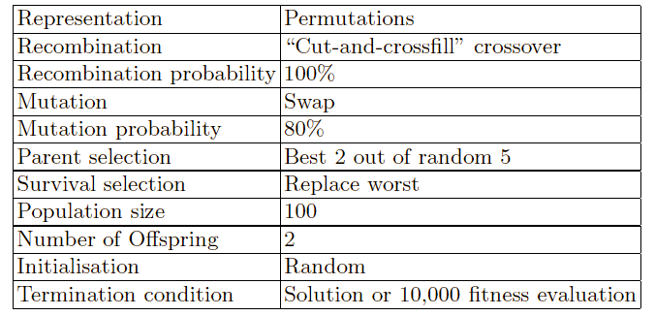
The 8-queens problem: Summary
Note that this is only one possible set of choices of operators and parameter values.

Slide 35
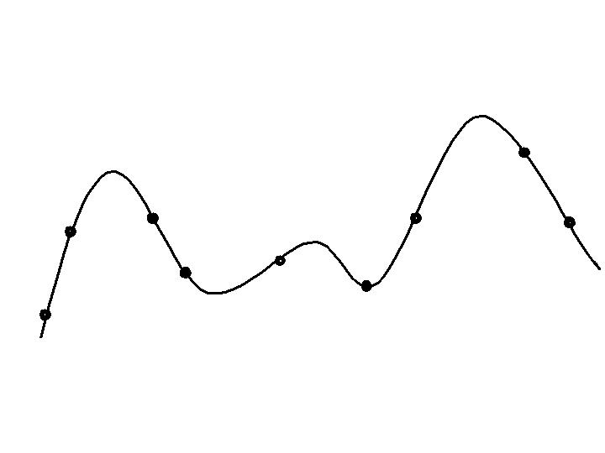
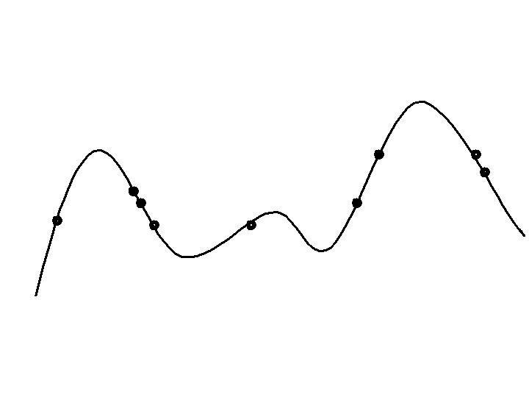
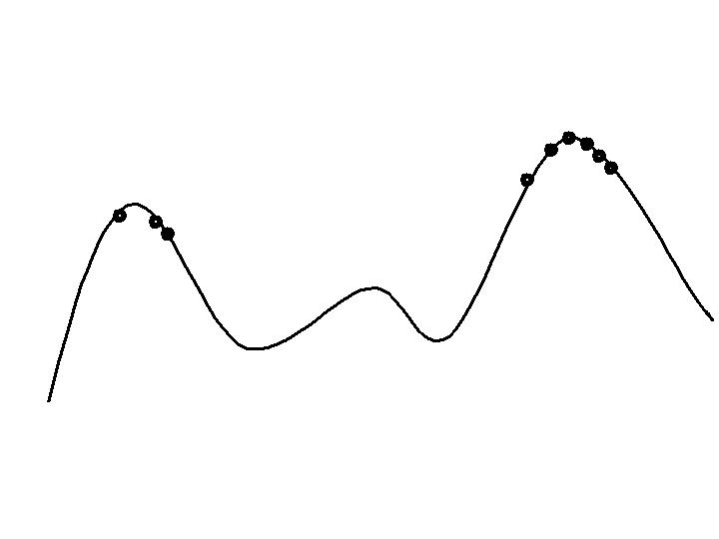
Typical EA behaviour: Stages
Stages in optimising on a 1-dimensional fitness landscape
Early stage:
quasi-random population distribution
Mid-stage:
population arranged around/on hills
Late stage:
population concentrated on high hills

Slide 36
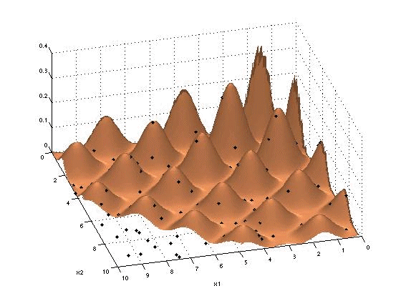
Working of an EA demo
Searching a fitness landscape without “niching”

Slide 37

Working of an EA demo
Searching a fitness landscape with “niching”

Slide 38
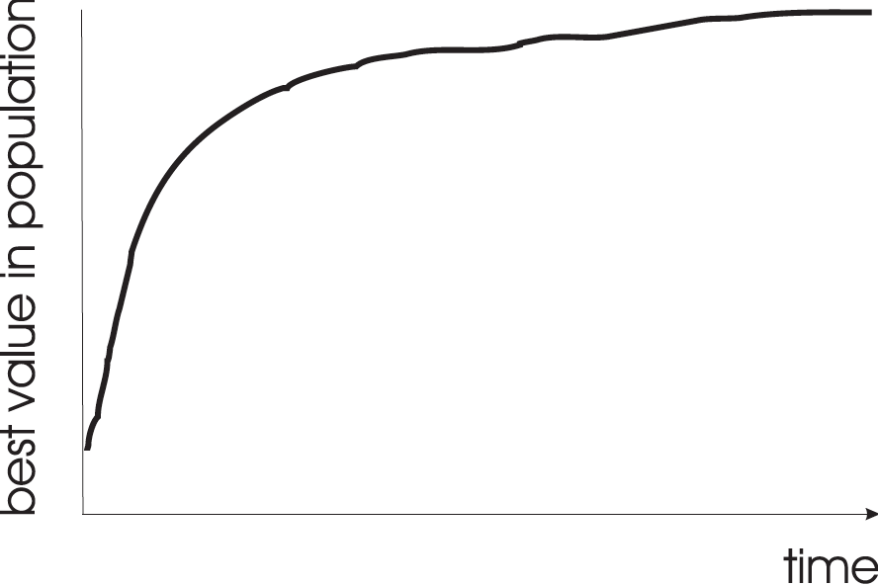
Typical EA behaviour: progression of fitness
Typical run of an EA shows so-called “anytime behavior”

Slide 39
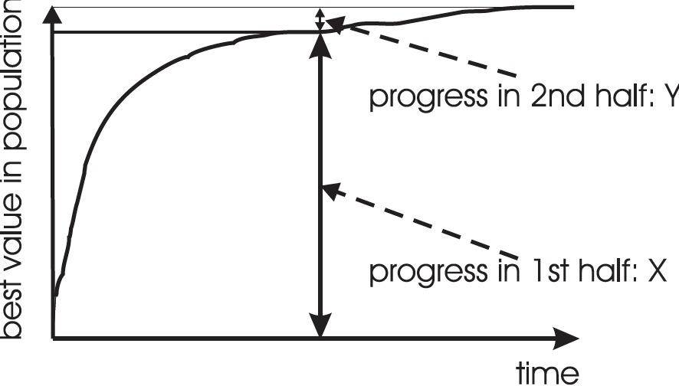
Are long runs beneficial?
Answer:
It depends on how much you want the last bit of progress
May be better to do more short runs

Slide 40
Is it worth expending effort on smart initialisation?
Best fitness in population
F
F: fitness after smart initialisation
T: time needed to reach level F after random initialisation
T
Time (number of generations)
Answer: it depends.
Possibly good, if good solutions/methods exist.
May not be necessary, EA will catch up quickly
Care is needed, see chapter/lecture on hybridisation.

Slide 41
Evolutionary Algorithms in context
EAs fall into the category of generate-and-test algorithms, a.k.a. trial-and-error algorithms
They are stochastic, population-based search algorithms
For most problems, a problem-specific tool may:
perform better than a generic search algorithm on most instances
have limited utility
not do well on all instances
EAs are meant to provide a robust tool that shows:
evenly good performance
over a range of problems and instances

Slide 42
EAs as problem solvers: Goldberg view (1989)
Special, problem tailored method
Evolutionary algorithm
Performance of methods on problems
Random search
Scale of “all” problems

Slide 43
EAs and domain knowledge
Trend in the 90’s: adding problem specific knowledge to EAs
(special variation operators, repair, etc)
Result: EA performance curve “deformation”:
better on problems of the given type
worse on problems different from given type
amount of added knowledge is variable
Theory suggests the search for an “all-purpose” algorithm may be fruitless

Slide 44
EAs as problem solvers: Michalewicz view (1996)
EA 4
EA 2
EA 3
EA 1
Performance of methods on problems
P
Scale of “all” problems

Slide 45
EC and global optimisation
Global optimisation: search for finding best solution x* out of some fixed set S
Deterministic approaches
e.g. box decomposition (branch and bound etc)
Guarantee to find x* ,
May have bounds on runtime, usually super-polynomial
Heuristic approaches (generate and test)
rules for deciding which x ∈ S to generate next
no guarantees that best solutions found are globally optimal
no bounds on runtime
Notes:
Two kind of solvers for global optimisation problem

Slide 46
EC and neighbourhood search
Many heuristics impose a neighbourhood structure on S
Such heuristics may guarantee that best point found is locally optimal e.g. Hill-Climbers:
But problems often exhibit many local optima
Often very quick to identify good solutions
EAs are distinguished by (the combination of) the following:
Use of population
Use of multiple, stochastic search operators
Variation operators with arity >1, thus combining information of more candidate solutions
Stochastic selection
Question: what is a neighbourhood in an EA?
Notes:
Can’t day anything about solution EA

Slide 47
General scheme of EAs – version 1
Parent selection
Parents
Intialization
Population
Variation
Termination
Offspring
Survivor selection

Slide 48
General scheme of EAs – version 2
Start
Variation
Evaluation
Selection
End

Slide 49
Q: What is the difference?
Start
Parent selection
Parents
Variation
Intialization
Population
Variation
Evaluation
Termination
Offspring
Survivor selection
Selection
End

Slide 50
Important points:
There are different diagrams to represent an EA scheme
Variation operators push towards novelty and selection operators push towards quality
Variation operators need to match the representation, selection operators are independent from the representation (hence, from the problem at hand)
Selection operators act on the population level and variation operators on the individual level

